Slide 1
PROJECT REVIEW
DESIGN AND ANALYSIS OF VOLTAGE FED CONVERTER FOR RESISTIVE LOAD
By
Awdesh Fernando (21BEE0304)
Sooryadev S. (21BEE0105)
School of Electrical Engineering,
VIT, Vellore
Under the Esteemed Guidance of
Dr. Arunkumar G
Professor Grade 1
Department of Energy and Power Electronics,
School of Electrical Engineering,
VIT, Vellore

Slide 2
Presentation Outline
Motivation
Need for Project
Literature Review
Research Gap
Research Objectives
Proposed Converter
Analysis and Design
Time Line

Slide 3
Motivation
Need for Project
Literature Review
Research Gap
Research Objectives
Proposed Converter
Analysis and Design
Problems with conventional converters:
Galvanic isolation: They lack galvanic isolation, which may reduce safety and expose the load to potential risks.
.
Voltage gains: Unable to achieve high voltage gains with a simplified topology, requiring complex designs for similar performance.
Efficiency: Typically, less efficient, requiring higher duty cycles to achieve the same voltage gains.
Desired output voltage: Not suitable for maintaining a desired output voltage in step-up or step-down DC-DC converter due to the absence of isolation (Transformer).

Slide 4
Motivation
Need for Project
Literature Review
Research Gap
Research Objectives
Proposed Converter
Analysis and Design
Need for the Proposed Converter
Galvanic isolation: In some designs, they offer galvanic isolation (with a transformer), improving safety and protecting the load.
Voltage gains: Achieving a high gain of 5× (80 V to 400 V) with a simplified topology.
Efficiency: Typically more efficient, as it achieves high voltage gains at lower duty cycles.
Desired output voltage: Used in DC-DC converters (step-up or step-down) to maintain a desired output voltage.

Slide 5
Motivation
Need for Project
Literature Review
Research Gap
Research Objectives
Proposed Converter
Analysis and Design
Literature Review
No | Title | Topology | Observations
1 | Voltage Fed Full Bridge DC-DC and DC-AC Converter for High-Frequency Inverter Using C2000. Singh, Atul, and Jabir VS | Voltage Fed Full Bridge | Demonstrated a high-frequency inverter using a voltage-fed full bridge DC-DC converter controlled by C2000 MCU. Prioritized compactness, galvanic isolation, and high efficiency. Implemented soft-start, PWM control, and flux-balancing to minimize core saturation.

Slide 6
Motivation
Need for Project
Literature Review
Research Gap
Research Objectives
Proposed Converter
Analysis and Design
Ref. | Title | Topology | Observations
2 | Voltage Fed and Current Fed Full Bridge Converter for the Use in Three Phase Grid Connected Fuel Cell Systems. Mohr, M., and F.-W. Fuchs. | Full Bridge Converter | Compared voltage-fed and current-fed full bridge converters for fuel cell systems above 20 kW. Found that leakage inductance significantly limits output voltage gain in voltage-fed converters, and clamping circuits are needed in current-fed designs. Efficiency is sensitive to component sizing and parasitic effects
3 | Analysis of a Voltage-Fed Full Bridge DC-DC Converter in Fuel Cell Systems. Averberg, A., and A. Mertens. | Voltage-Fed Full Bridge DC-DC Converter | Conducted analytical modeling of voltage-fed full bridge converters, focusing on transformer turns ratio, leakage inductance, and output inductor size. Emphasized that small leakage inductance and optimized transformer design are crucial for high gain and stable operation.

Slide 7
Motivation
Need for Project
Literature Review
Research Gap
Research Objectives
Proposed Converter
Analysis and Design
Based on the literature review, the following research gaps were identified:
Most studies focus on high-power or fuel cell systems, often >1 kW, with complex control systems.
Existing studies focus on output voltages lower (28 V, 12 V)
Designs achieve either very high voltage gains (~31.7×) or unspecified gains, which may not be necessary for certain applications.​
Limited data on efficiency performance of converters at power levels typical for household solar applications.

Slide 8
Motivation
Need for Project
Literature Review
Research Gap
Research Objectives
Proposed Converter
Analysis and Design
Based on the gaps found in the research, the objectives considered for this work are listed below
Our focus on low-power or fuel cell systems, <1 kW, with complex control systems.
Our studies focus on output voltages with higher value (400 V)
Targets a specific resistive load application, achieving a high gain of 5× (80 V to 400 V) with a simplified topology.
Achieves 87.6% efficiency using discrete components and idealized design—suitable for educational, lab-scale, or compact energy conversion systems.

Slide 9
Motivation
Need for Project
Literature Review
Research Gap
Research Objectives
Proposed Converter
Analysis and Design
Design Specification
Parameters | Values | Spec
Input Voltage | 80 | V
Output Voltage | 400 | V
Duty Ratio | 0.42 | -
MOSFET | V_{DS}=1200V, I_{D}=52A | IMW120R045M1
Diode | V_{DC}=1200V, I_{F}=20A | IDWD20G120C5
Frequency | 50 | kHZ
Transformer Turns Ratio | 6 (N2/N1)
Capacitor | 10 | µF
Resistor | 800 | Ω

Slide 10
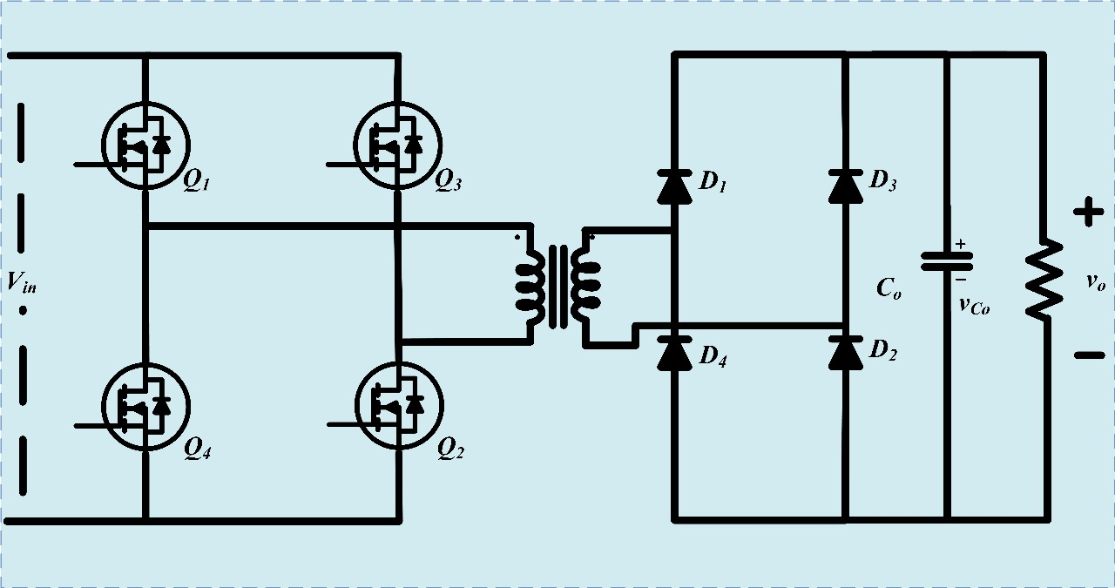
Motivation
Need for Project
Literature Review
Research Gap
Research Objectives
Proposed Converter
Analysis and Design
Proposed Circuit Diagram

Slide 11
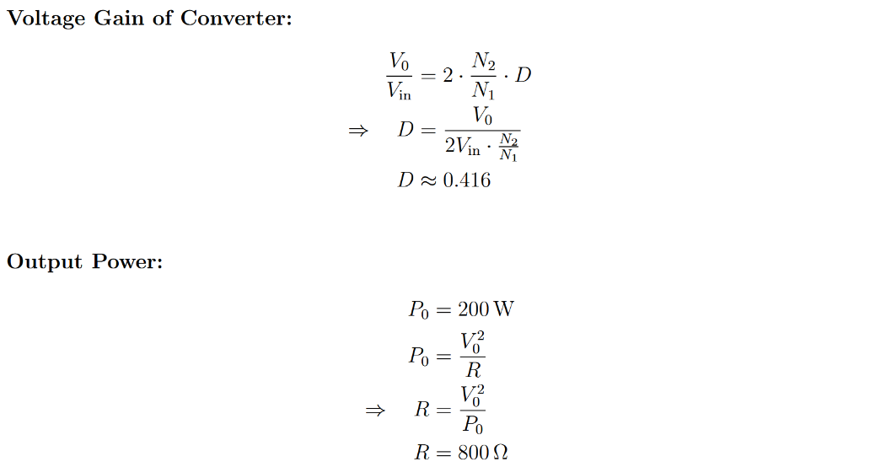
Motivation
Need for Project
Literature Review
Research Gap
Research Objectives
Proposed Converter
Analysis and Design
Design Formula

Slide 12
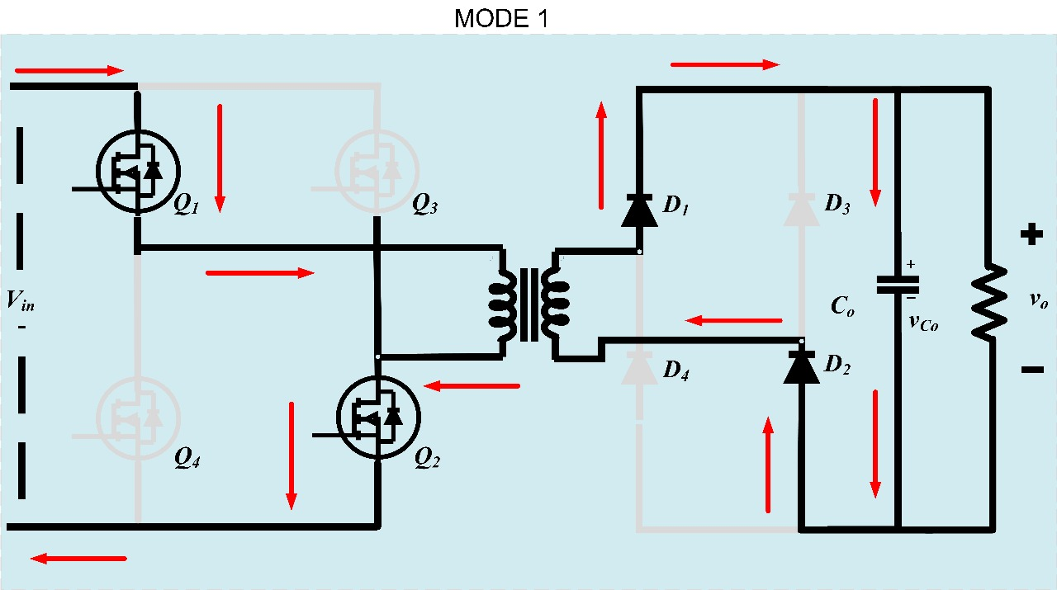
Motivation
Need for Project
Literature Review
Research Gap
Research Objectives
Proposed Converter
Analysis and Design
Modes of Operation
Mode : 1

Slide 13
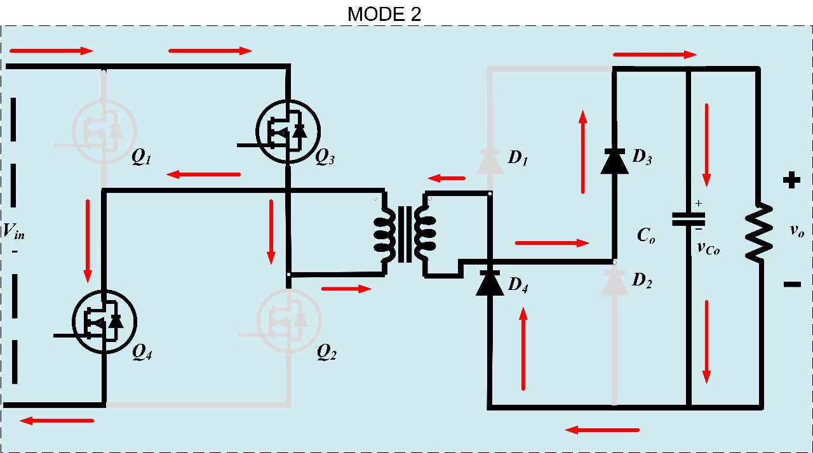
Motivation
Need for Project
Literature Review
Research Gap
Research Objectives
Proposed Converter
Analysis and Design
Modes of Operation
Mode : 2

Slide 14
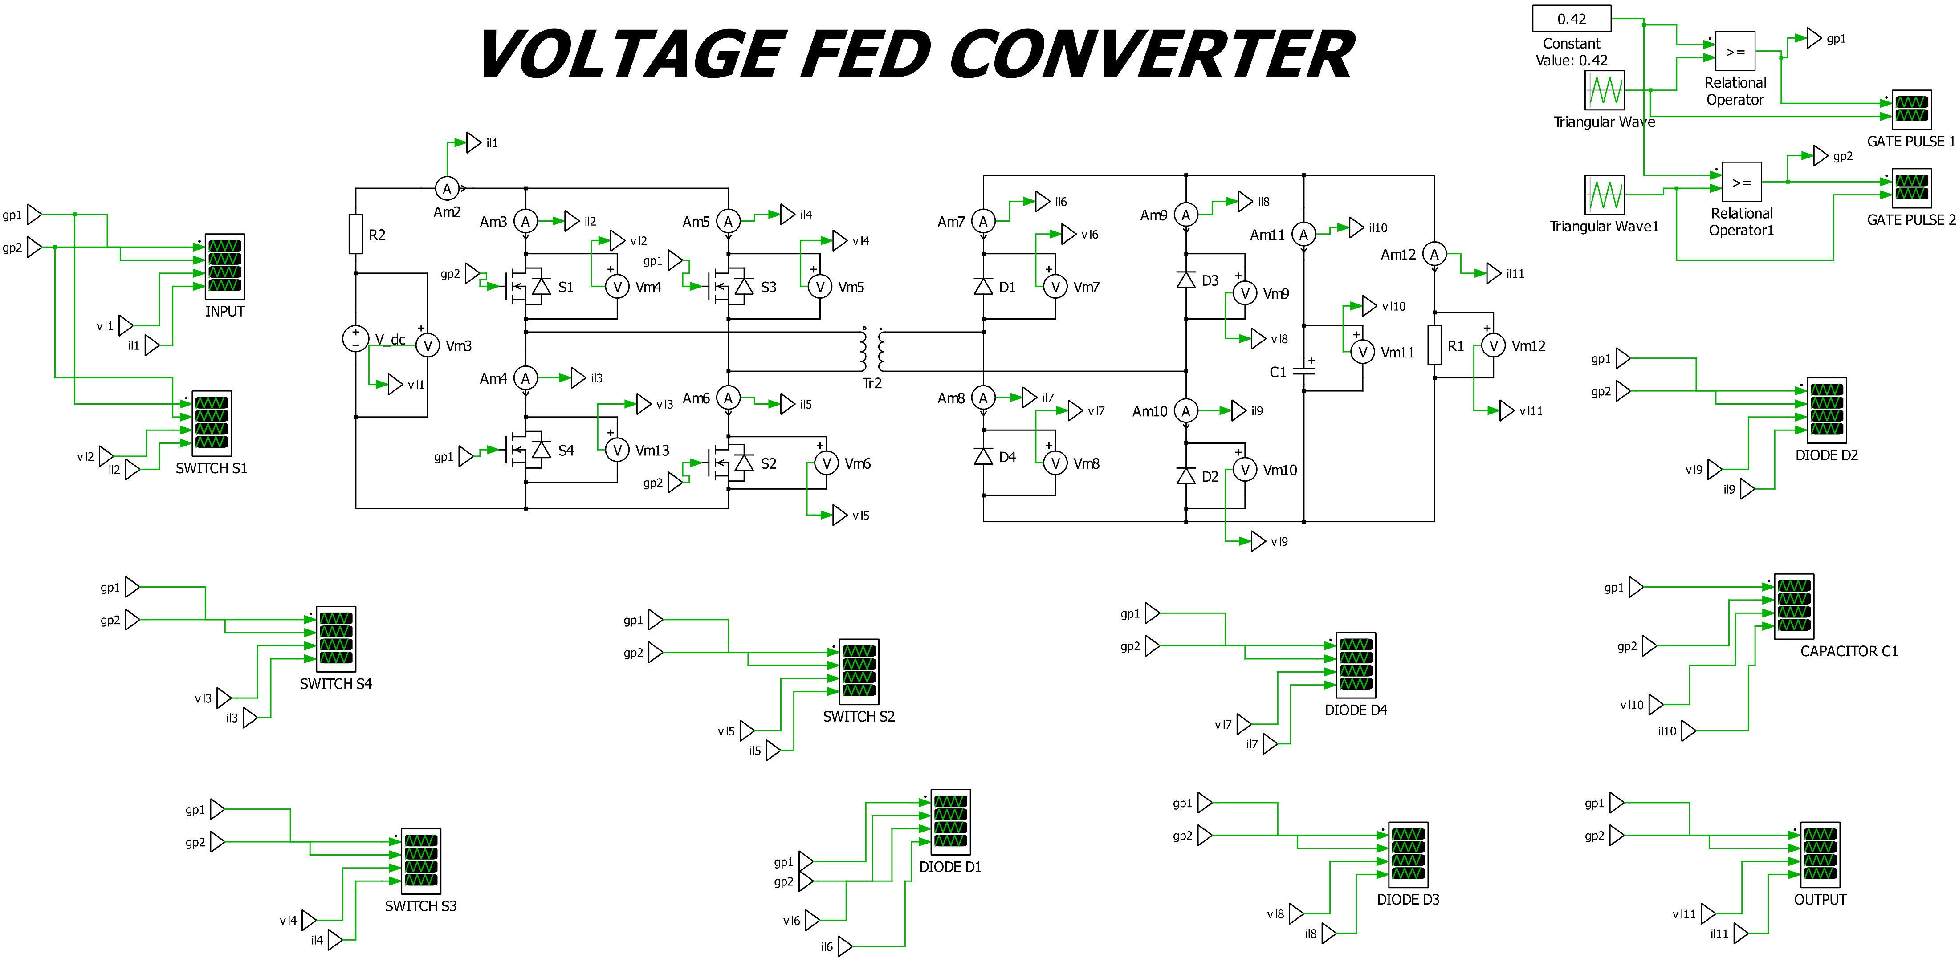
Motivation
Need for Project
Literature Review
Research Gap
Research Objectives
Proposed Converter
Analysis and Design
PLECS Simulation

Slide 15
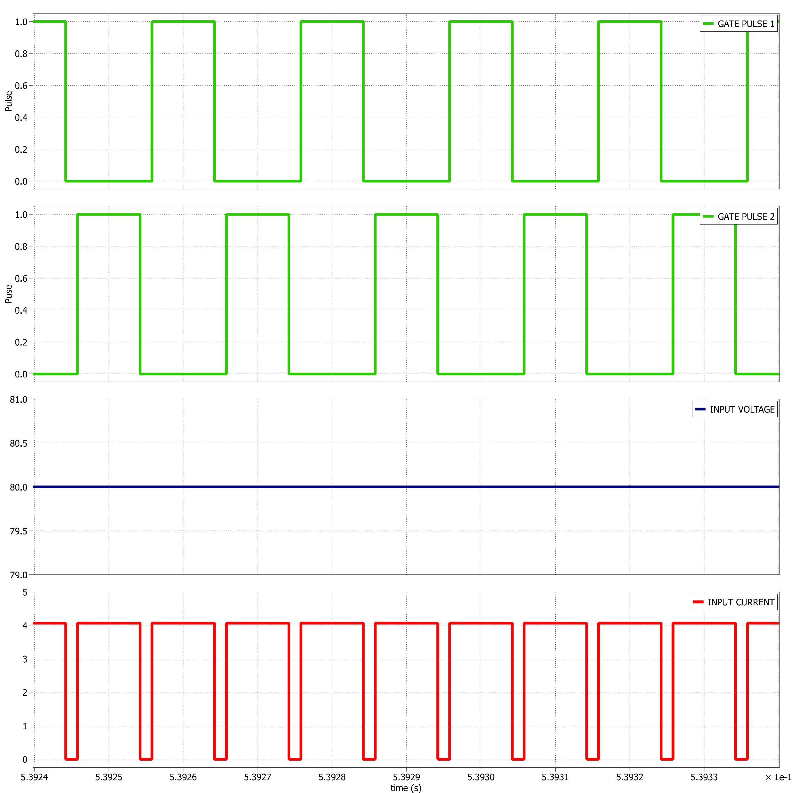
Motivation
Need for Project
Literature Review
Research Gap
Research Objectives
Proposed Converter
Analysis and Design
Simulation Result
Source Voltage and Current

Slide 16
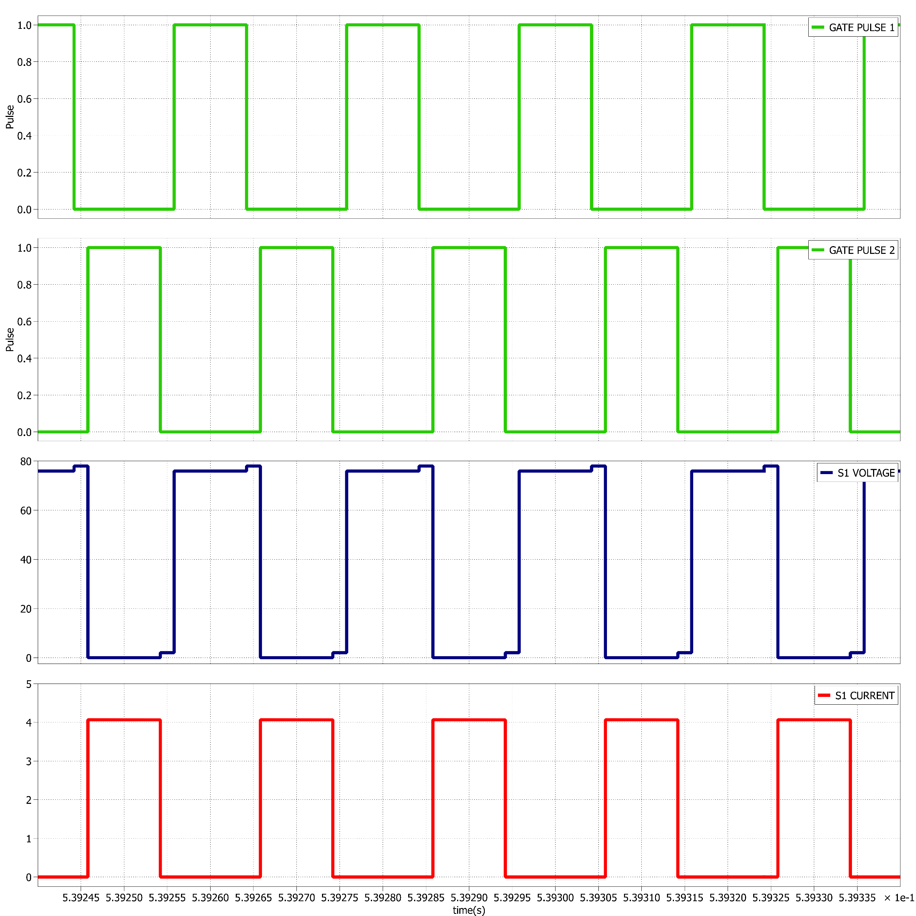
Motivation
Need for Project
Literature Review
Research Gap
Research Objectives
Proposed Converter
Analysis and Design
Simulation Result
SWITCH S1 Voltage and Current

Slide 17
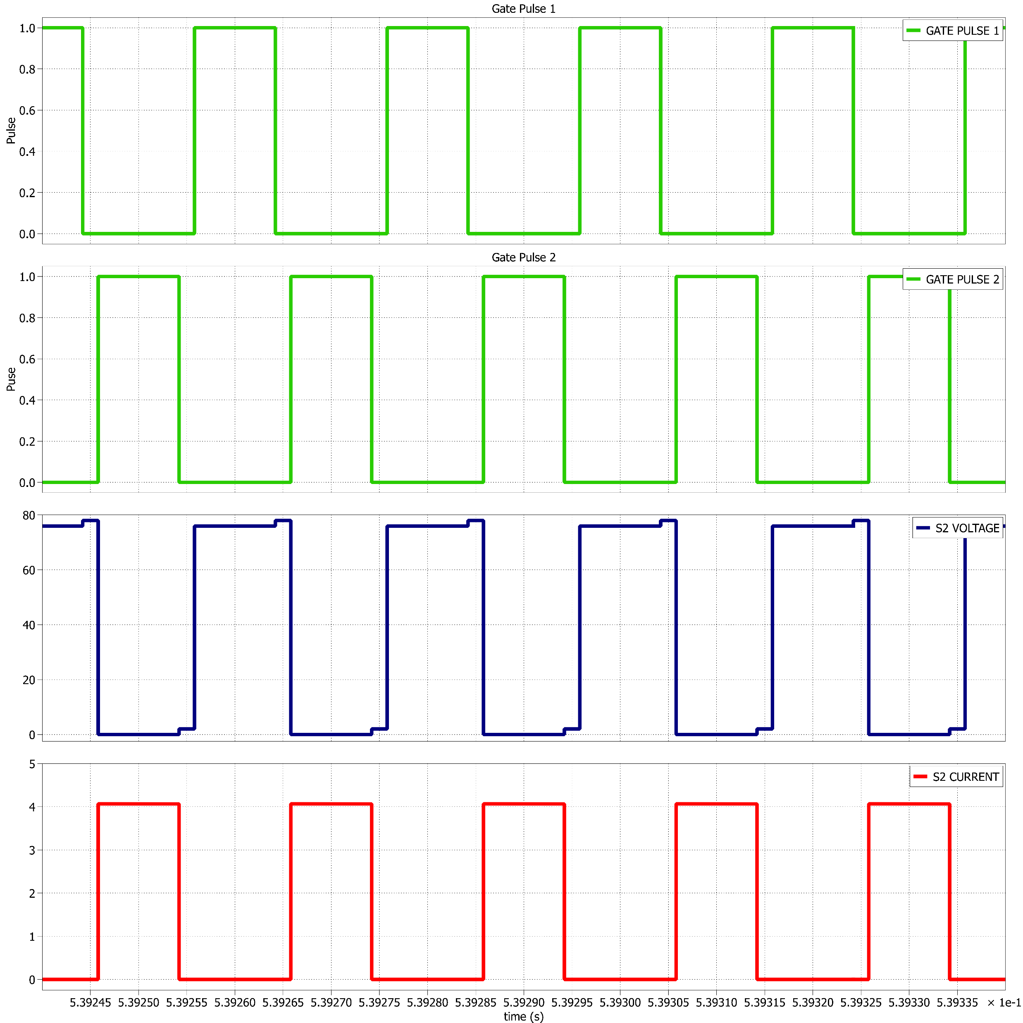
Motivation
Need for Project
Literature Review
Research Gap
Research Objectives
Proposed Converter
Analysis and Design
Simulation Result
SWITCH S2 Voltage and Current

Slide 18
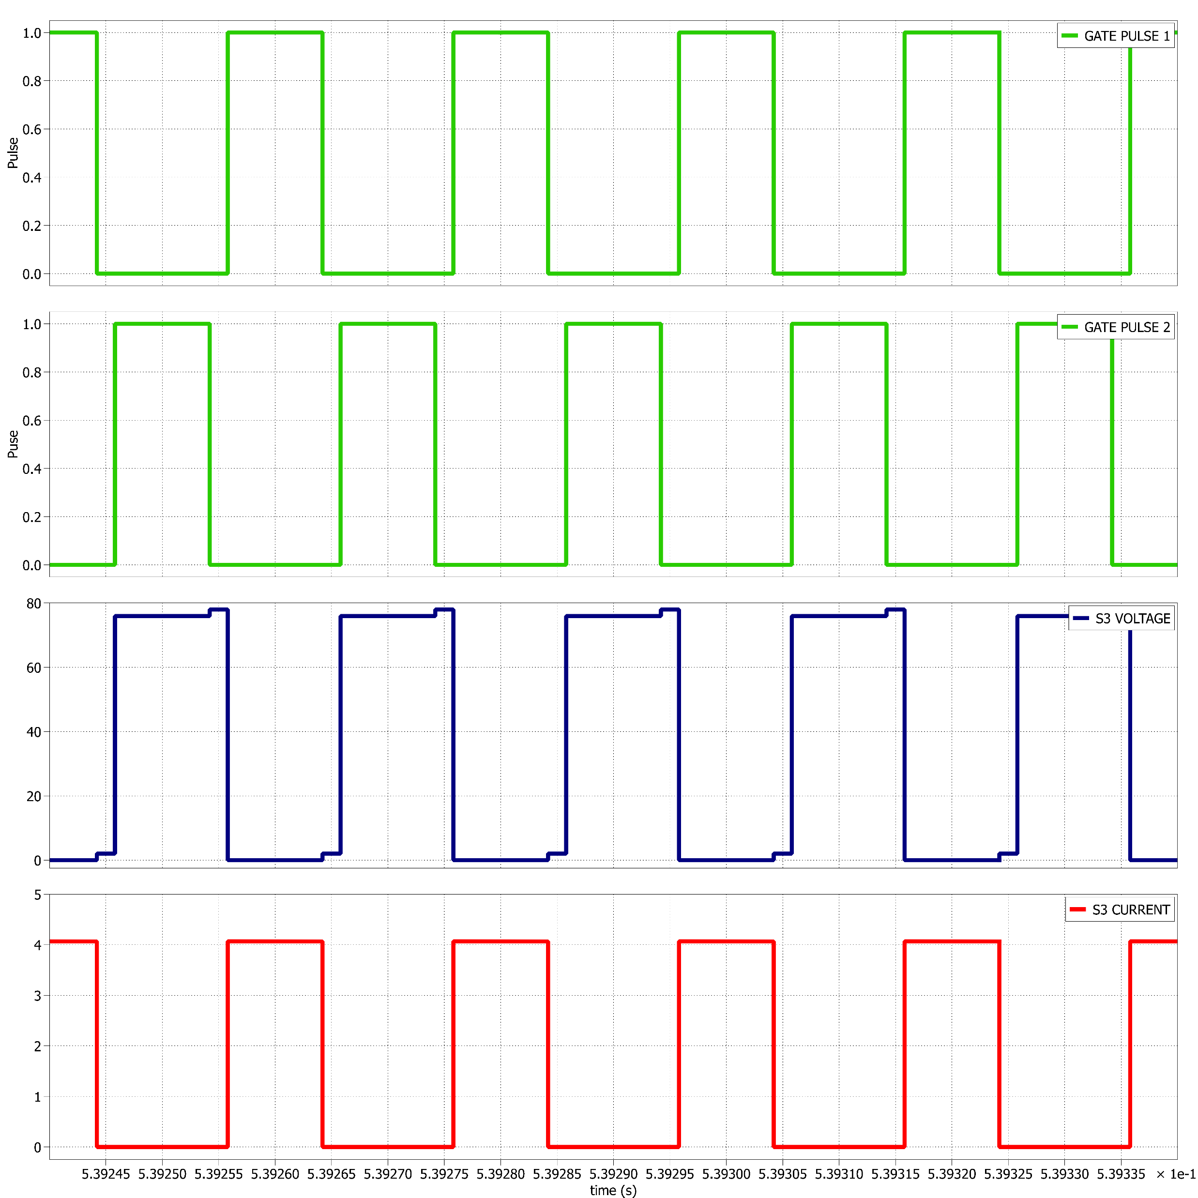
Motivation
Need for Project
Literature Review
Research Gap
Research Objectives
Proposed Converter
Analysis and Design
Simulation Result
SWITCH S3 Voltage and Current

Slide 19

Motivation
Need for Project
Literature Review
Research Gap
Research Objectives
Proposed Converter
Analysis and Design
Simulation Result
SWITCH S4 Voltage and Current

Slide 20
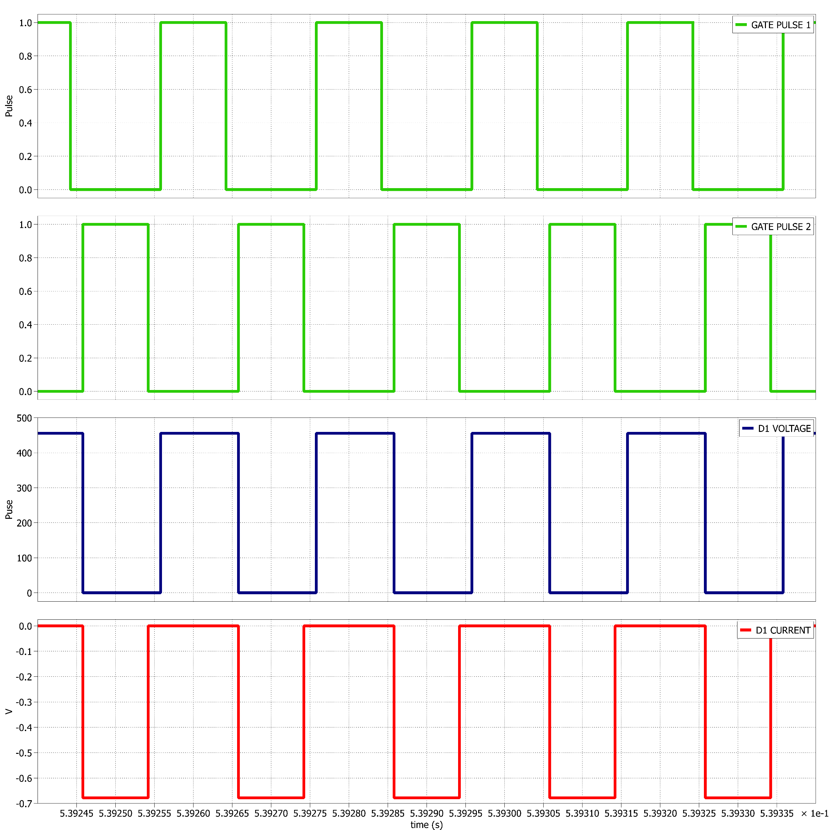
Motivation
Need for Project
Literature Review
Research Gap
Research Objectives
Proposed Converter
Analysis and Design
Simulation Result
DIODE D1 Voltage and Current

Slide 21
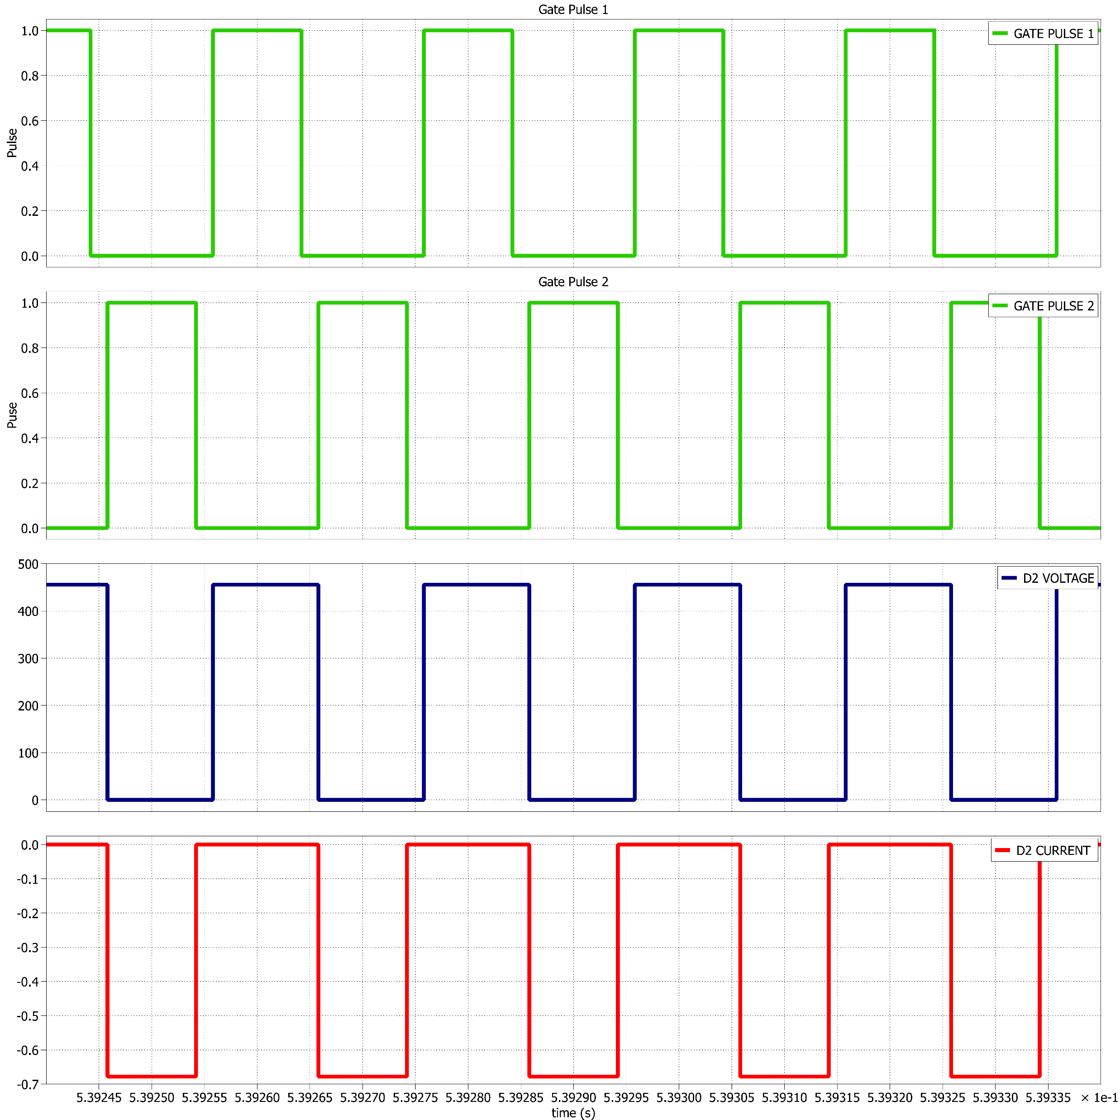
Motivation
Need for Project
Literature Review
Research Gap
Research Objectives
Proposed Converter
Analysis and Design
Simulation Result
DIODE D2 Voltage and Current

Slide 22
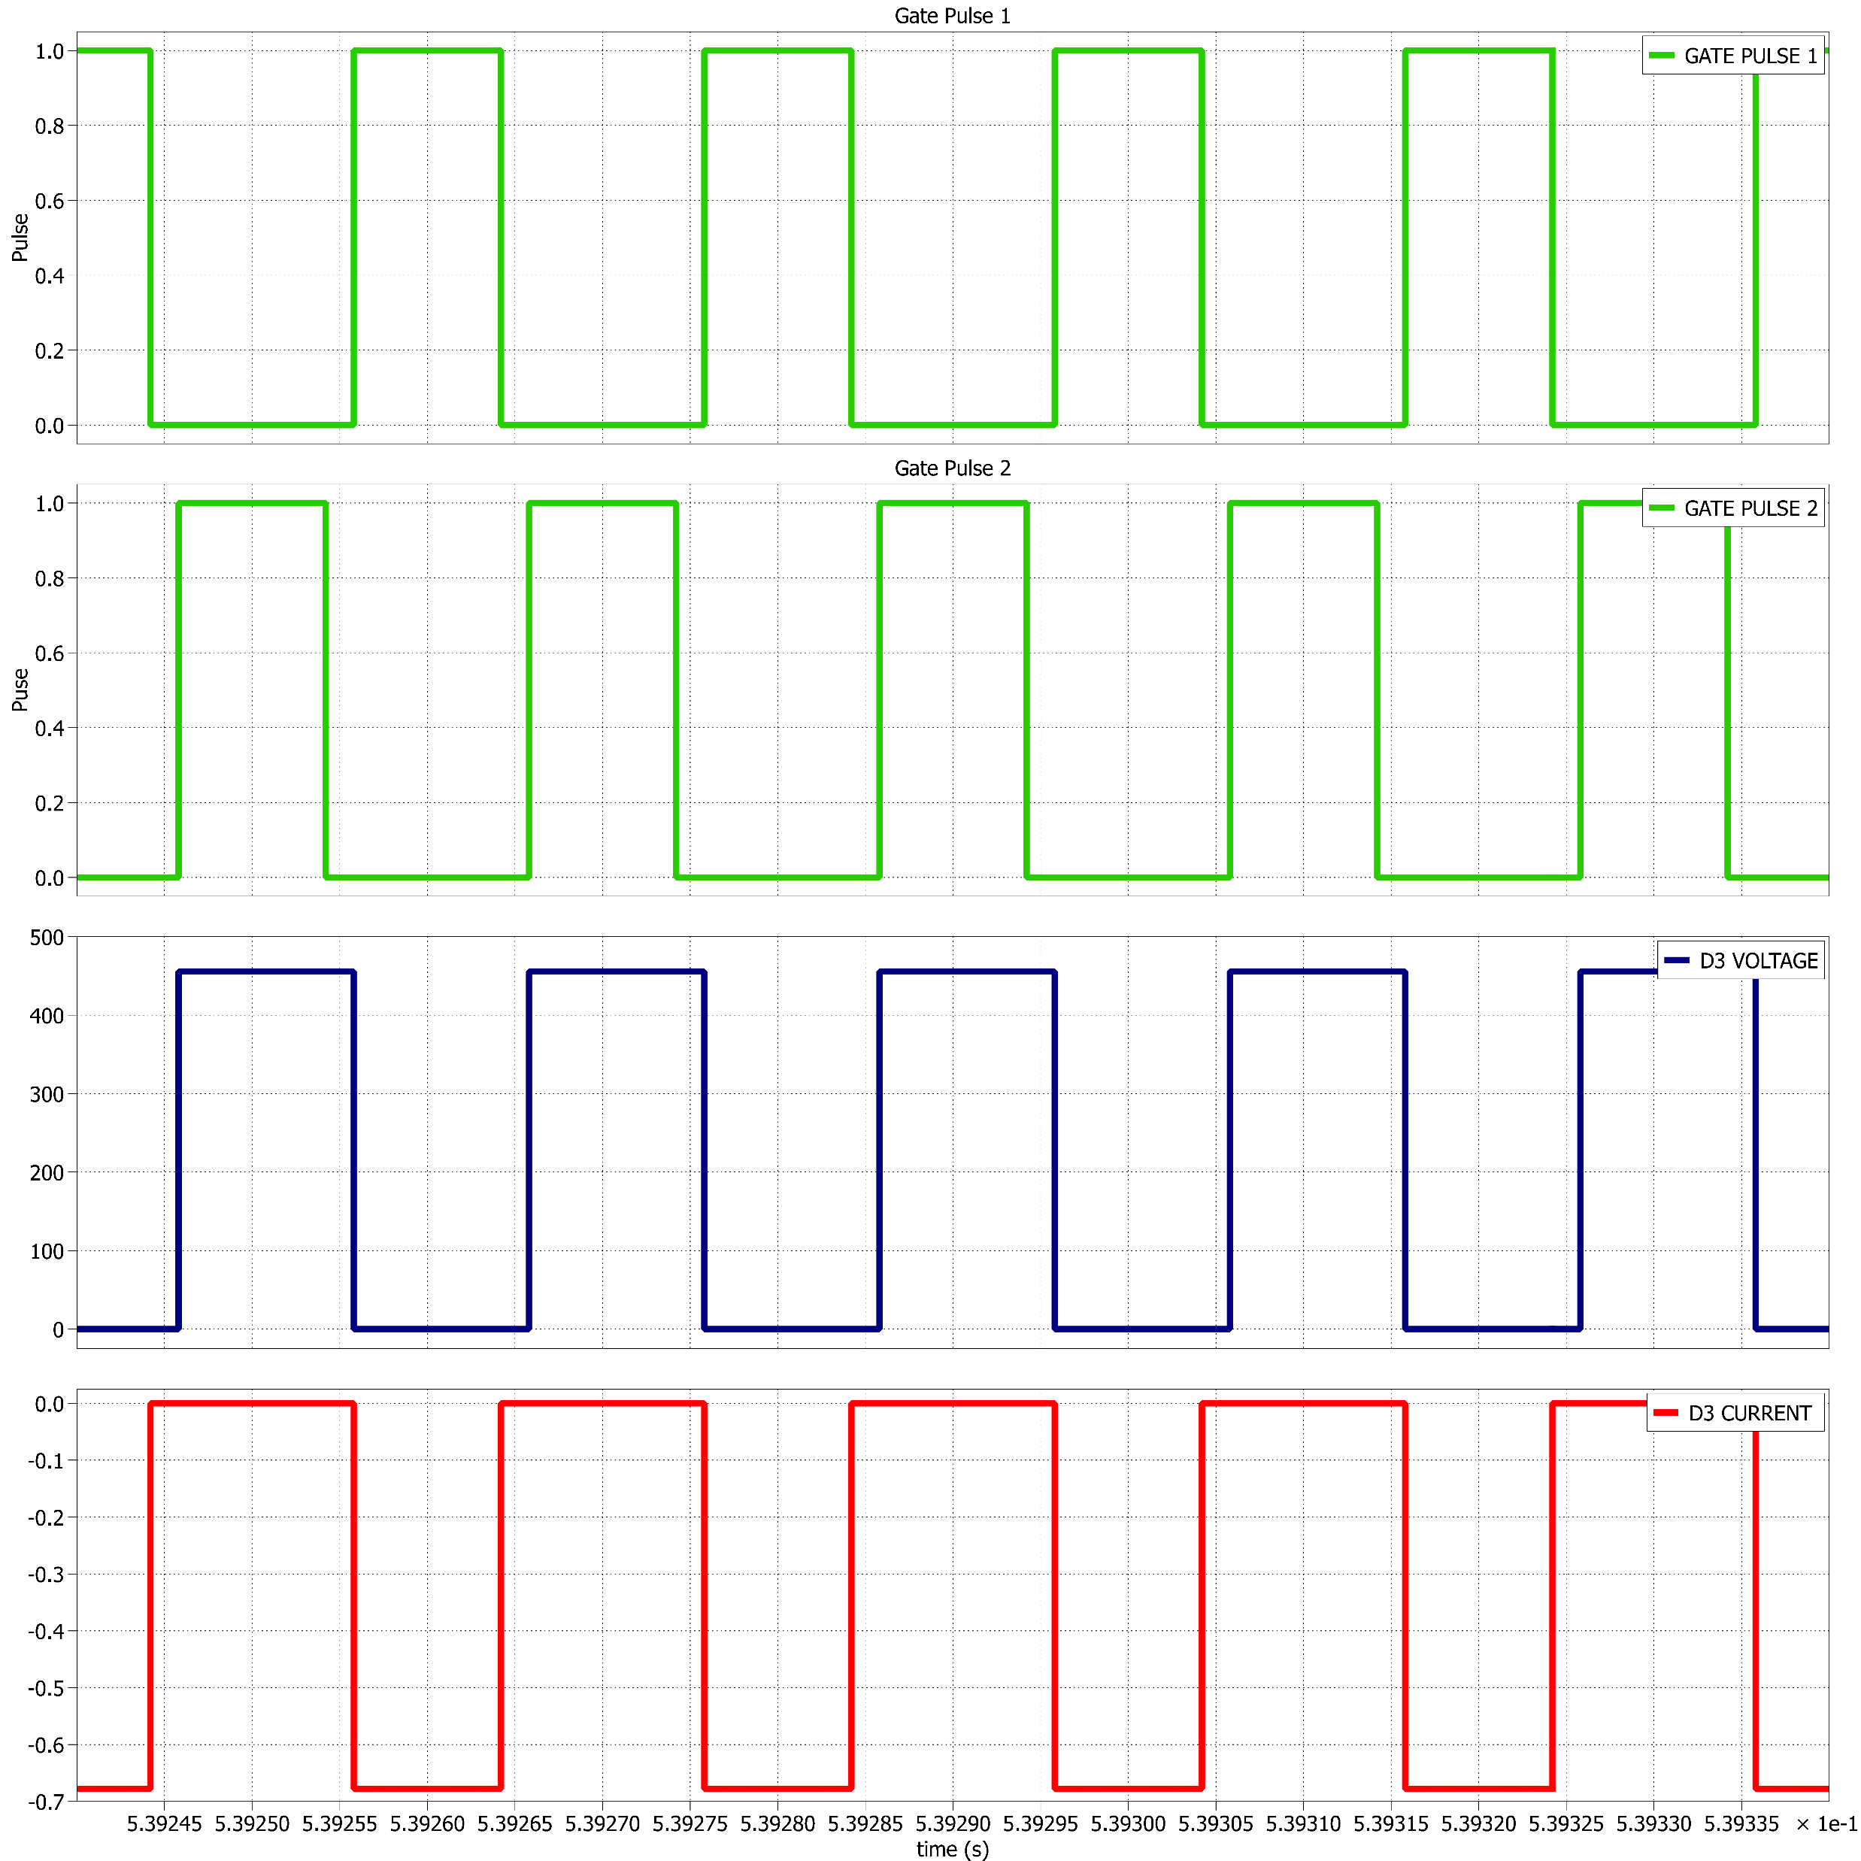
Motivation
Need for Project
Literature Review
Research Gap
Research Objectives
Proposed Converter
Analysis and Design
Simulation Result
DIODE D3 Voltage and Current

Slide 23
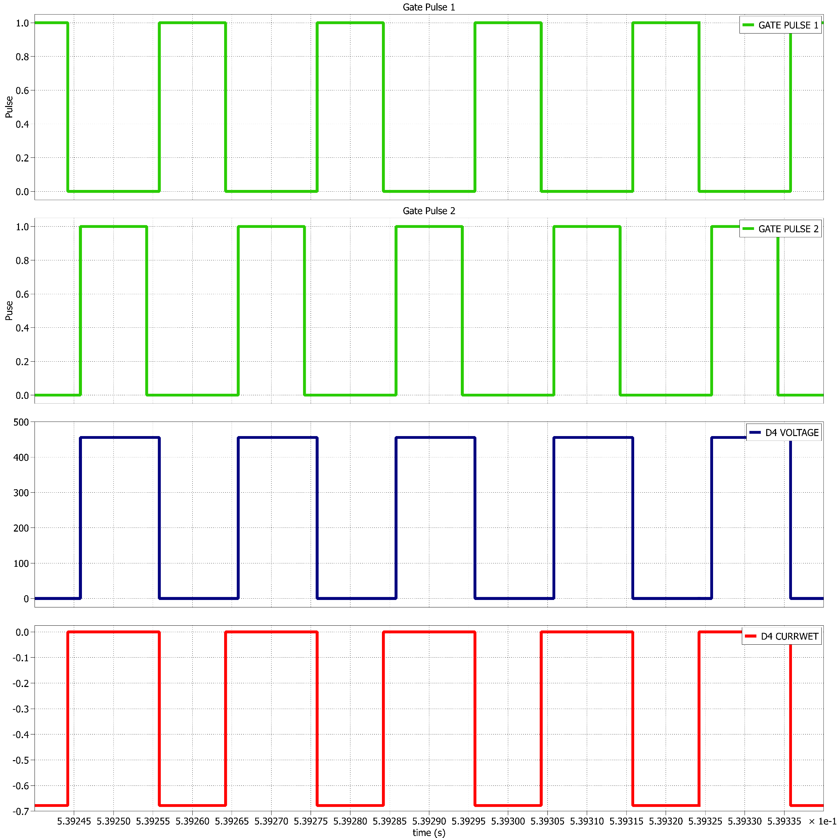
Motivation
Need for Project
Literature Review
Research Gap
Research Objectives
Proposed Converter
Analysis and Design
Simulation Result
DIODE D4 Voltage and Current

Slide 24
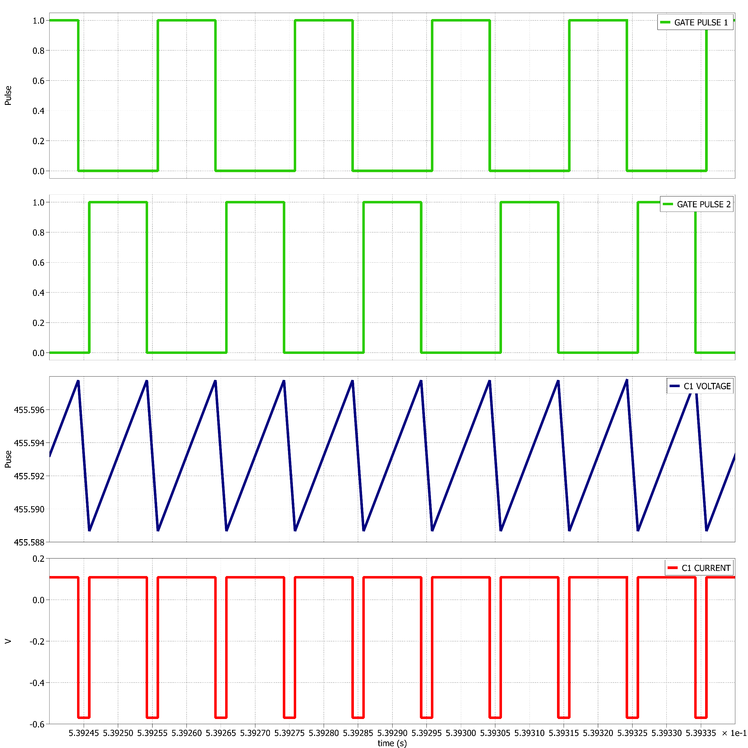
Motivation
Need for Project
Literature Review
Research Gap
Research Objectives
Proposed Converter
Analysis and Design
Simulation Result
Capacitor C1 Voltage and Current

Slide 25
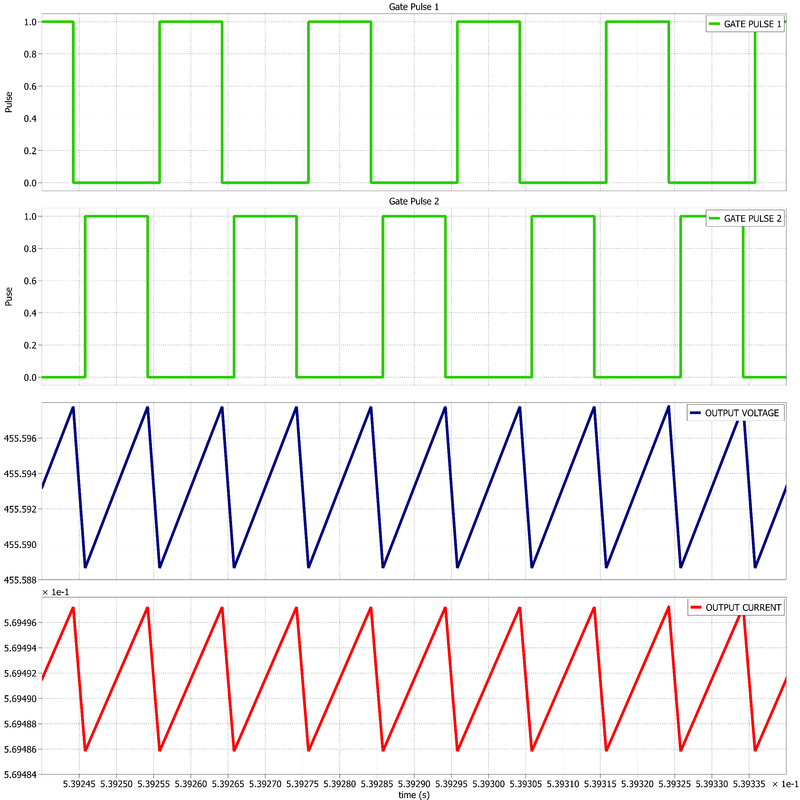
Motivation
Need for Project
Literature Review
Research Gap
Research Objectives
Proposed Converter
Analysis and Design
Simulation Result
OUTPUT Voltage and Current

Slide 26
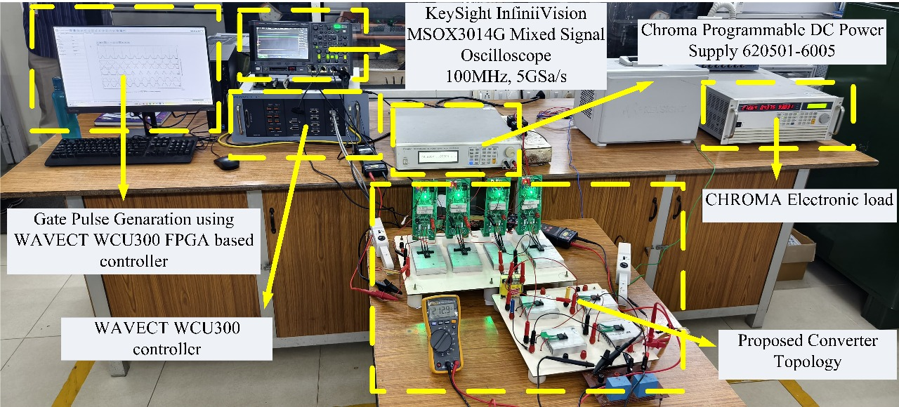
Motivation
Need for Project
Literature Review
Research Gap
Research Objectives
Proposed Converter
Analysis and Design
Hardware Setup

Slide 27
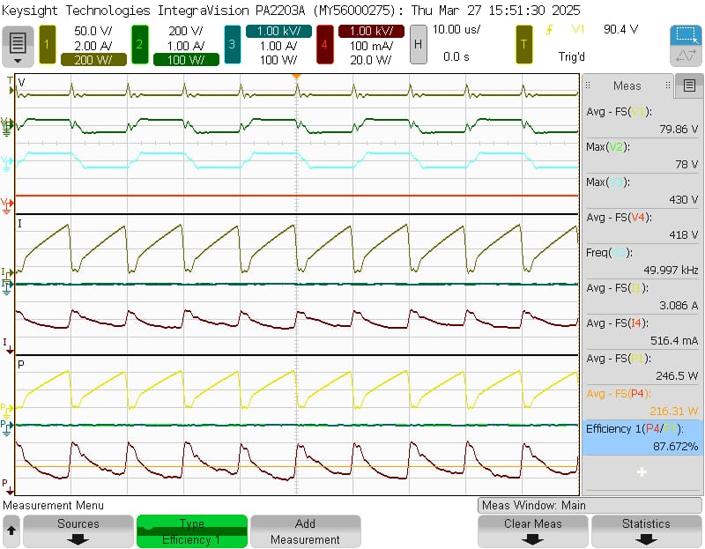
Motivation
Need for Project
Literature Review
Research Gap
Research Objectives
Proposed Converter
Analysis and Design
Hardware Results

Slide 28
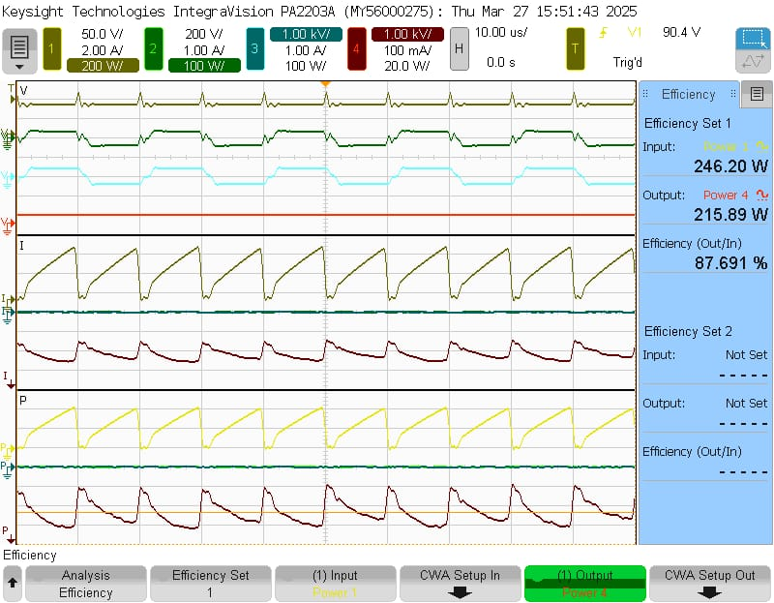
Motivation
Need for Project
Literature Review
Research Gap
Research Objectives
Proposed Converter
Analysis and Design
Hardware Results

Slide 29
Motivation
Need for Project
Literature Review
Research Gap
Research Objectives
Proposed Converter
Analysis and Design
Application
PV based system application
Electric vehicle power systems

Slide 30
References
S.No | References
1. | Mohr, M., and F-W. Fuchs. "Voltage fed and current fed full bridge converter for the use in three phase grid connected fuel cell systems." 2006 CES/IEEE 5th international power electronics and motion control conference. Vol. 1. IEEE, 2006.
2. | Averberg, A., and A. Mertens. "Analysis of a voltage-fed full bridge dc-dc converter in fuel cell systems." 2007 IEEE Power Electronics Specialists Conference. IEEE, 2007.
3. | Texas Instruments. Voltage Fed Full Bridge DC-DC and DC-AC Converter for High-Frequency Inverter Using C2000. Texas Instruments, Apr. 2021, www.ti.com/lit/an/sprabw0d/sprabw0d.pdf
4. | Bimal K Bose “Power Electronics and Motor Drives: Advances and Trends”
5. | Hart, Daniel W, Power electronics, 2011, Tata McGraw-Hill Education
6. | Infineon Technologies AG. IDWD20G120C5 5th Generation CoolSiC™ 1200V Schottky Diode Datasheet, Version 2.1, 1 Mar. 2021. www.infineon.com
7. | Infineon Technologies AG. IMW120R045M1 CoolSiC™ 1200V SiC Trench MOSFET Datasheet, Version 2.6, 11 Dec. 2020. www.infineon.com

Slide 31
Time Line
Steps | January | February | March | April | May
1 | Topic Selection
2 | Review of Literature
3 |  | Simulation (PLECS/MATLAB)
4 |  | Hardware implementation and results, debugging
5 |  |  | Documentation
6 |  |  |  | Final Report

Slide 32
THANK YOU

